Slide 1
hporvrs
GOOGLE CLASSROOM CODE

Slide 2
TEXT BOOKS
Discrete Mathematics and its Applications, 7th Edition by K. Rosen, McGraw Hill
Discrete Mathematics with Applications, 5th Edition by Susanna S. Epp Gagne
Discrete Mathematics, Schaum's outlines, 4th edition

Slide 3
Basic Structures: Sets, Functions

Slide 4
Sets

Slide 5
INTRODUCTION
Set
An unordered collection of distinct objects
The objects are called the elements or members of the set
Example: a set of vowels, V = {a, b, c, d, e}
If a set A contains an element a and does not contain b then:
It is written as: a ∈ A, b ∉ A
Frequency and order
Order does not matter
{1, 2, 3} and {2, 1, 3} are the same set
Frequency does not matter
{1, 1, 2, 3} and {1, 2, 3} are the same set
{1, 2, 1, 3, 3, 2, 1} and {1, 2, 3} are the same

Slide 6
NOTATIONS
Roster Method
All the elements of the sets are enclosed with {}
Consider a set S of positive odd integers less than 10
Notation using Roster method: S = {1, 3, 5, 7, 9}
Set Builder Notation
The properties of all the elements are characterized
S = {x | properties of x}
Consider a set S of positive odd integers less than 10
Notation using Builder method: S = {x ∈ Z⁺ | x is odd and x < 10}

Slide 7

IMPORTANT SETS
Z = {…., -2, -1, 0, 1, 2, ….}
Set of all integers
Z⁺ = {1, 2, 3, ….}
Set of all positive integers
N = {0, 1, 2, ….}
Set of all natural numbers
Q = {$\frac{p}{q}$ | p ∈ Z, q ∈ Z and q ≠ 0}
Set of all rational numbers
R
Set of all real numbers
R⁺
Set of all positive real numbers
C
Set of all complex numbers

Slide 8
INTERVALS
[a, b] = {x | a ≤ x ≤ b}
[2, 6] = {2, 3, 4, 5, 6}
Considering x as integer
[a, b) = {x | a ≤ x < b}
(a, b] = {x | a < x ≤ b}
[2, 6) = {2, 3, 4, 5}
(2, 6] = {3, 4, 5, 6}
(a, b) = {x | a < x < b}
(2, 6) = {3, 4, 5}
[a, b] is called closed interval from a to b
(a, b) is called open interval from a to b

Slide 9
VENN DIAGRAM
A graphical method to represent sets
Universal set (U) is represented by rectangle
Sets are represented as circle or other geometrical figure
Sometimes elements are represented as points
Represent the set of vowels V = {a, e, i, o, u} in Venn diagram
a
U
u
e
V
o
i

Slide 10
SUBSET AND SUPERSET
A is a subset of B, and B is a superset of A
If and only if every element of A is also an element of B
Notation: A ⊆ B
A is a subset of B
Notation: B ⊇ A
B is a superset of A
Consider a set B = {1, 2, 3, 4, 5}
Identify the subset relationship between A and B from the following:
A = {2, 4, 5}
✅A ⊂ B
A = {2, 5, 4}
✅ A ⊂ B
A = {2, 5, 6}
❌ A ⊄ B
A = {1, 2, 3, 4, 5}
✅ A = B

Slide 11
SUBSET AND SUPERSET
A is a subset of B, and B is a superset of A
If and only if the following quantification is true
∀_{x}(x ∈ A → x ∈ B)
For all x, if x belongs to A, then that x must belong to B
Mean, every element of the subset must belong to the superset
There should be no element in subset that is not present in superset

Slide 12
PROPER SUBSET
A is a proper subset of B
If A ⊂ B but A ≠ B
Quantification: ∀_{x}(x ∈ A → x ∈ B) ^{Λ} Ǝ_{x}(x ∈ B ^{Λ} x ∉ A)
Every element of subset must belong to superset
But there is at least one element in the superset that is not in subset
Consider a set B = {1, 2, 3, 4, 5}
Identify the proper subset relationship between A and B:
A = {2, 4, 5}
✅A ⊂ B
A = {2, 5, 4}
✅ A ⊂ B
A = {2, 5, 6}
❌ A ⊄ B
A = {1, 2, 3, 4, 5}
❌ A = B

Slide 13
SIZE OF A SET
The number of distinct element in a set is called the size of that set
The size of a set A is denoted as |A|
Let, A = {1, 5, 7}
Size of A, |A| = 3
Let, A = {1, 1, 3, 7, 5, 7}
Size of A, |A| = 4

Slide 14
NULL SET
A set with no elements
Notation: ∅
| ∅ | = 0
Null set is a subset of any set

Slide 15
ALL SUBSET
Find all the subsets of A = {2, 6, 4}
{2}
How many subsets?
{6}
8
{4}
What about |A| = n?
{2, 6}
2^{n}
{2, 4}
{6, 4}
{2, 6, 4}
∅

Slide 16
ALL SUBSET
Find all the subsets of A = {2, 6, 4}
Here the number of elements in A is 3
Find all the combinations of 0 and 1 of size 3
0 0 0
∅
0 0 1
{4}
0 1 0
{6}
0 1 1
{6, 4}
1 0 0
{2}
1 0 1
{2, 4}
1 1 0
{2, 6}
1 1 1
{2, 6, 4}

Slide 17
POWER SET
Power set of a set S is the set of all subsets of S
Let, S = {2, 7}
Power set of S, P(S) = {∅, {2}, {7}, {2, 7}}
|P(S)| = 2^{|S|}

Slide 18
ORDERED TUPLE
In set theory many times ordered collection is important
The ordered collection is known as tuple
A tuple is enclosed with ( )
(a, b, c) is a ordered tuple where a is the first and c is the last element
If a ≠ b then (a, b) ≠ (b, a)
Two tuples (a, b, c) and (p, q, r) is equal if and only if
a = p
b = q
c = r
A ordered tuple with two elements is called ordered pair
(a, b) is an ordered pair but (a, b, c) is not

Slide 19
CARTESIAN PRODUCTS
Cartesian products of two sets A and B is
The set of all ordered pairs (a, b), where a ∈ A and b ∈ B
Denoted by A x B
A x B = {(a, b) | a ∈ A ^{Λ} b ∈ B}
Find the Cartesian product of A = {1, 2} and B = {a, b, c}
A x B = {(1, a), (1, b), (1, c), (2, a), (2, b), (2, c)}
Find the Cartesian product of B = {a, b, c} and A = {1, 2}
B x A = {(a, 1), (a, 2), (b, 1), (b, 2), (c, 1), (c, 2)}
As (1, a) and (a, 1) not equal, means the elements of A x B and B x A
are different, hence A x B ≠ B x A

Slide 20
CARTESIAN PRODUCTS
Find A x B x C; A = {0, 1}. B = {3, 2}, C = {5, 6, 7}
{(0,3,5), (0,3,6), (0,3,7), (0,2,5), (0,2,6), (0,2,7), (1,3,5), (1,3,6), (1,3,7), (1,2,5), (1,2,6), (1,2,7),}
Note that, A x B x C ≠ (A x B) x C
Find A² and A³; where A = {0, 1}
A² = A x A
= {0, 1} x {0, 1}
= {(0,0), (0,1), (1,0), (1,1)}
A³ = A x A x A
= {0, 1} x {0, 1} x {0, 1}
= {(0,0,0), (0,0,1), (0,1,0), (0,1,1), {(1,0,0), (1,0,1), (1,1,0), (1,1,1)}

Slide 21
SET NOTATION WITH QUANTIFIERS
What do the statement mean?
∀_{x ∈ R} (x² ≥ 0)
The statement states that, for all x, x² ≥ 0
Where the domain of x is real numbers
On other words, for every real number x, x² ≥ 0

Slide 22
TRUTH SETS
For a predicate/propositional function P(x)
The truth set of P(x) is the set of the elements of x in domain
For which P(x) is true
Find the truth set of the following predicates where the domain is Z
P(x): |x| = 1
{-1, 1}
Q(x): x² = 2
∅
R(x): |x| = x
N

Slide 23
SET OPERATIONS
Operations to combine two or more sets
Let A and B are two sets and U is the universal set
Operation | Symbol | Notation
Union
U
A U B
Intersection
⋂
A ⋂ B
Difference
-
A - B
Complement
-
Ā

Slide 24
UNION
Let, A and B are two sets
The Union of A and B is the set that contains elements present in either A or B or both
Denoted by A U B
U
A U B = {x | x ∈ A ^{V} x ∈ B}
Let, A = {1, 3, 5} and B = {1, 2, 3}
A
B
Hence, A U B = {1, 2, 3, 5}

Slide 25
INTERSECTION
Let, A and B are two sets
The Intersection of A and B is the set that contains elements present in both A and B
Denoted by A ⋂ B
U
A ⋂ B = {x | x ∈ A ^{Λ} x ∈ B}
Let, A = {1, 3, 5} and B = {1, 2, 3}
A
B
Hence, A ⋂ B = {1, 3}

Slide 26
DIFFERENCE
Let, A and B are two sets
The Difference of A and B is the set that contains elements present in either A but not in B
Denoted by A - B
U
A - B = {x | x ∈ A ^{Λ} x ∉ B}
Let, A = {1, 7, 3, 5} and B = {1, 2, 3}
A
B
Hence, A U B = {7, 5}

Slide 27



COMPLEMENT
Let, A is the set and U is the universal set
The Complement of A is the set that contains elements present inU but not in A
Denoted by $\overline{A}$
U
$\overline{A}$= U - A = {x | x ∈ U ^{Λ} x ∉ A}
Let, U = {1, 7, 3, 5} and A = {1, 2, 3}
A
Hence, $\overline{A}$= {7, 5}

Slide 28
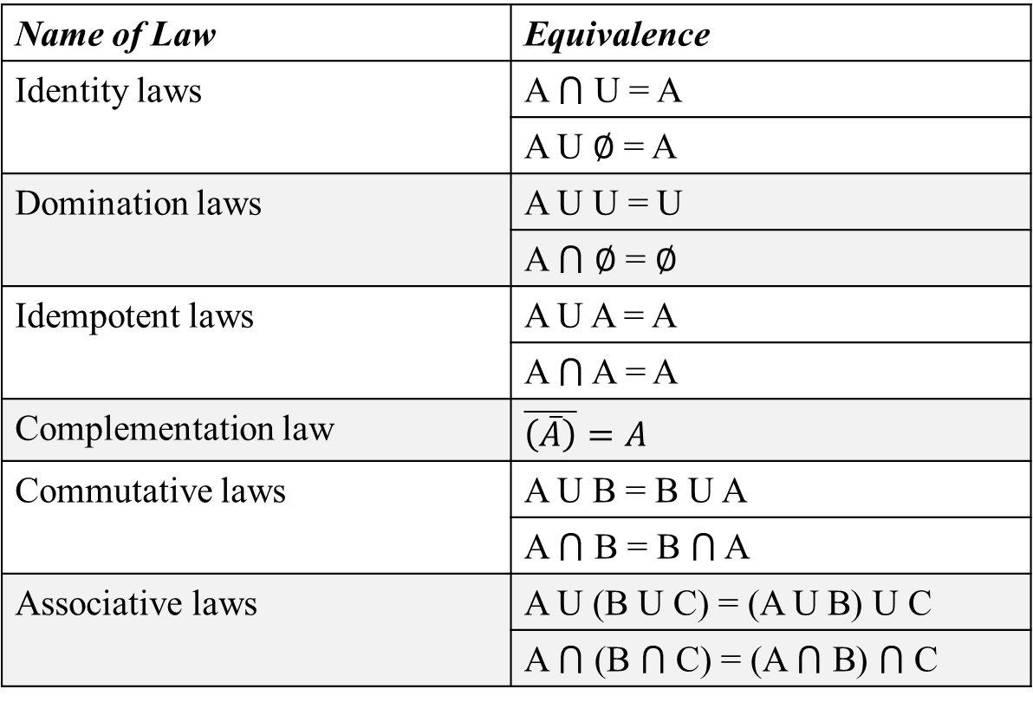
SET IDENTITIES
Name of Law | Equivalence
Identity laws | A ⋂ U = A
 | A U ∅ = A
Domination laws | A U U = U
 | A ⋂ ∅ = ∅
Idempotent laws | A U A = A
 | A ⋂ A = A
Complementation law | $$\overline{\left(\overline{A}\right)}=A$$
Commutative laws | A U B = B U A
 | A ⋂ B = B ⋂ A
Associative laws | A U (B U C) = (A U B) U C
 | A ⋂ (B ⋂ C) = (A ⋂ B) ⋂ C

Slide 29
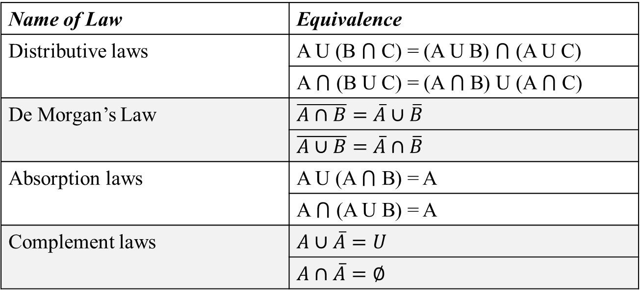
SET IDENTITIES
Name of Law | Equivalence
Distributive laws | A U (B ⋂ C) = (A U B) ⋂ (A U C)
 | A ⋂ (B U C) = (A ⋂ B) U (A ⋂ C)
De Morgan’s Law | $$\overline{A∩B}=\overline{A}∪\overline{B}$$
 | $$\overline{A∪B}=\overline{A}∩\overline{B}$$
Absorption laws | A U (A ⋂ B) = A
 | A ⋂ (A U B) = A
Complement laws | $$A∪\overline{A}=U$$
 | $$A∩\overline{A}=∅$$

Slide 30








EXERCISE
Using Set Builder notation prove: $\overline{A∩B}=\overline{A}∪\overline{B}$
$\overline{A∩B}$ = {x | x $∉$ A $∩$ B}
= {x | $¬$( x $∈$ (A $∩$ B) )}
[By definition of does not belong to]
= {x | $¬$( x $∈$ A $∧$x $∈$ B) )}
[By definition of set intersection]
= {x | $¬$( x $∈$ A ) ^{V}$¬$(x $∈$ B)}
[De Morgan’s law]
= {x | ( x $∉$ A ) ^{V} (x$∉$ B)}
[By definition of does not belong to]
= {x | ( x$∈$ $\overline{A}$ ) ^{V} (x $∈\overline{B}$)}
[By definition of complement]
= {x | ( x$∈$ $(\overline{A}$ U $\overline{B}$) )}
[By definition of Union]
= $\overline{A}$ U $\overline{B}$

Slide 31
Functions

Slide 32
INTRODUCTION
A function takes several values as arguments/ parameters and returns a single element
Let a function is: f(x, y) = x² + y²
f(3, 4) = 25
Arguments: (3, 4)
Return: 25
A function may have many arguments but returns a single element

Slide 33
INTRODUCTION
Definition
Let A, B be nonempty sets.
A function from A to B is assignment of exactly one element of B to each element of A.
f(a) = b is written if b is the unique element of B assigned by f to the element a of A
If f is a function from A to B, we write f : A $→$ B
A is the domain/ input of f
B is the co-domain/ output of f
A function is also called mappings or transformations

Slide 34
EXAMPLE
Consider the following mapping of from integer-number to corresponding grades.
A function f is defined such that, it takes a number as input and returns the corresponding grade.
Number | Grade
80-100 | A
60-79 | B
40-59 | C
0-39 | F
Domain=?
Co-domain=?
f(75) = ?
f(43) = ?
Domain = {$x∈Z | x≥0∧x≤100$}
Co-domain = {$A, B, C ,F$}
f(75) = B
f(43) = C

Slide 35
EXAMPLE
Consider the result system of a University has five different grades {A, B, C, D, F}. Now in the first year-first semester, there are five male students in the University who obtained the grades as follows:
Student | Grade
Dhrubo | A
Siam | C
Deb | B
Mehrab | A
Sarafat | F
Now a function f is defined that takes a student as argument and returns his grade of first year-first semester.
Domain=?
Co-domain=?
Illustrate a figure of mapping.
Domain = {Dhrubo, Siam, Deb, Mehrab, Sarafat}
Co-domain = {A, B, C, D, F}
Range/ Image = {A, B, C, F}

Slide 36
EXAMPLE
Student | Grade
Dhrubo | A
Siam | C
Deb | B
Mehrab | A
Sarafat | F
Domain = {Dhrubo, Siam, Deb, Mehrab, Sarafat}
Co-domain = {A, B, C, D, F}
Range/ Image = {A, B, C, F}
So, Co-domain is the set of possible elements that a function can map
Range is the set of elements that a function exactly maps

Slide 37
EXAMPLE
Student | Grade
Dhrubo | A
Siam | C
Deb | B
Mehrab | A
Sarafat | F
Dhrubo
A
Siam
B
Deb
C
Mehrab
D
Sarafat
F
Domain
Co-domain

Slide 38
EXAMPLE
Let, f be the function that assigns the last two bits of a bit string of length two or greater to that string. For example f(11010) = 10.
Domain = ?
Co-domain=?
Range=?
Domain = {x | x is a bit string and length of x is greater than one}
All bit strings of length 2: 00, 01, 10, 11
So, when length is two, the co-domain is {00, 01, 10, 11}
All bit strings of length 3: 000, 001, 010, 011, 100, 101, 110, 111
So, when length is three, the co-domain is {00, 01, 10, 11}
It is clear that, for any bit string with a length greater than one will have the same co-domain = {00, 01, 10, 11}
The range will equal to the co-domain

Slide 39
ONE-TO-ONE FUNCTION
Consider, a function that takes the salary of an employee as an argument and returns his/ her amount tax (10% of the salary).
f(x) = 0.1x
Now, f(5000) = ?
Ans: 500
Which means that, if the salary is 5000, then the tax is 500
Now, if someone asks that, if the tax is 500 then what is the salary?
Ans: 5000
Means, the salary is calculatable from tax and the tax is calculatable from salary as well
So, this is a One-to-One function

Slide 40
ONE-TO-ONE FUNCTION
Consider the following function
f(x) = x²
Now, f(5) = ?
Ans: 25
Now, if someone asks that, if x² is 25 then can it be answered?
Ans: No
Because x can be either 5 or -5
Means, x² is calculatable from x, but x is not calculatable from x²
So, this is not a One-to-One function
Means, if an element in the Range is associated with multiple elements of the Domain then the function is not One-to-One
Here, 25 from Range is associated with both 5 and -5 in Domain

Slide 41
ONE-TO-ONE FUNCTION
Dhrubo
A+
Dhrubo
A+
Siam
A
Siam
A
Deb
B
Deb
B
Mehrab
C
Mehrab
C
Sarafat
D
Sarafat
D
F
F
Not One-to-One function
One-to-One function

Slide 42
ONE-TO-ONE FUNCTION
Again, consider the following function
f(x) = x²
Why is it not a One-to-One function?
Because there are more than one values in Domain for which the function returns the same
f(-5) = f(5) but -5 $≠$ 5
Means, a function is not One-to-One if f(a) = f(b) but a and b might not be equal, they can be different
But, a function is One-to-One if f(a) = f(b) and a must equal to b
Means, there are not multiple elements for which the function returns the same

Slide 43
ONE-TO-ONE FUNCTION
Let a function is: f: A $→$B
Let any two elements p and q from the domain
The function is One-to-One:
If f(p) = f(q) then p = q
To prove a function One-to-one let the function is f(x)
Find f(p)
Find f(q)
Do f(p) = f(q)
Solve f(p) = f(q)
If p = q is found then f is One-to-one

Slide 44
ONE-TO-ONE FUNCTION
Determine whether f(x) = x + 1 is One-to-one or not.
f(p) = p + 1
f(q) = q + 1
f(p) = f(q)
p + 1= q + 1
p = q
The function is One-to-one

Slide 45


ONE-TO-ONE FUNCTION
Determine whether f(x) = x² is One-to-one or not.
f(p) = p²
f(q) = q²
f(p) = f(q)
p² = q²
p = $±$q
p = $−$q does not imply p = q
The function is not One-to-one.

Slide 46
ONTO FUNCTION
If the Range and Co-domain of a function is equal
Dhrubo
A
Dhrubo
A
Siam
B
Siam
B
Deb
C
Deb
C
Mehrab
D
Mehrab
D
Sarafat
F
Sarafat
F
Not Onto
Onto

Slide 47
ONTO FUNCTION
Consider a function f : Z $→$ Z where f(x) = x²
Determine whether the function is Onto or not.
Ans: No
Here Domain and co-domain both are Z
Now, as the domain is Z so the range will be {1, 4, 9, 16, ….}
But the co-domain includes all integers including the negatives
So, this function is not Onto

Slide 48
ONTO FUNCTION
Consider a function f : R $→$ R where f(x) = x²
Determine whether the function is Onto or not.
Ans: No
Here Domain and co-domain both are R
Now, as the domain is R so the range will consist of positive values of R
But the co-domain includes all real number including the negatives
So, this function is not Onto

Slide 49
ONTO FUNCTION
Consider a function f : R $→$ R⁺ where f(x) = x²
Determine whether the function is Onto or not.
Ans: Yes
Here Domain is R and co-domain is R⁺
Now, as the domain is R so the range will consist of positive values of R
So, this function is Onto

Slide 50
ONTO FUNCTION
A function f: A $→$ B is called Onto or a Surjection:
If and only if for every element b $∈$ B
there is an element in a $∈$A with f(a) = b

Slide 51
RELATION
Dhrubo
A
Student | Grade
Dhrubo | A, D
Siam | C
Deb | B
Mehrab | A
Sarafat | F
Siam
B
Deb
C
Mehrab
D
Sarafat
F
Is the above relation a function?
No
f(Dhrubo) = ?
This can not be answered certainly from the above relation
Because answer can be either A or D. But, it is known that, a function always returns a single element
This type relation is not function. A function is always a relation but a relation is not always a function.

Slide 52
INVERSE FUNCTION
Let, f: A $→$ B is an One-to-One function:
The inverse function of f is denoted as f⁻¹ that:
assigns to an element b belonging to B the unique element a in A such that f(a) = b
Hence, if f(a) = b then f⁻¹(b) = a
f must be a One-to-One function
Otherwise f⁻¹(b) will be mapped to multiple elements in A, that violates the definition of a function
f⁻¹ is denoted as f⁻¹: B $→$A

Slide 53
INVERSE FUNCTION
Let, f: Z $→$ Z be such that, f(x) = x + 1.
Is f invertible?
If yes, then find the inverse.
First need to check: it is One-to-one or not. [Done previously]
The function is One-to-One
Now, find the value of x from the given function that is the inverse function
x = f(x) - 1
f⁻¹(x) = f(x) - 1

Slide 54

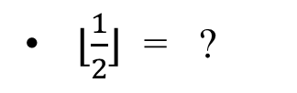
FLOOR FUNCTION
Let a real number is x
The Floor function assigns the closest integer that is less than or equal to x
Denoted by ⌊x⌋
⌊2.1⌋ = ?
2
⌊3.8⌋ = ?
3
⌊4⌋ = ?
4
⌊$\frac{1}{2}$⌋ = ?
0
⌊-$\frac{1}{2}$⌋ = ?
-1

Slide 55

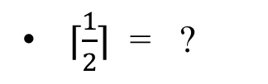
CEILING FUNCTION
Let a real number is x
The Ceiling function assigns the closest integer that is greater than or equal to x
Denoted by ⌈x⌉
⌈2.1⌉ = ?
3
⌈3.8⌉ = ?
4
⌈4⌉ = ?
4
⌈$\frac{1}{2}$⌉ = ?
1
⌈-$\frac{1}{2}$⌉ = ?
0

Slide 56
SEQUENCE

Slide 57
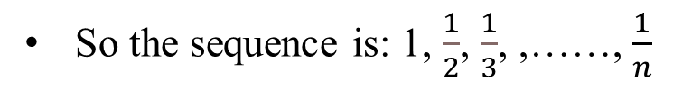
INTRODUCTION
Sequence
A discrete structure to represent ordered list
For example: 1, 2, 4, 8, 16, …….., 2^{n}
Notation: {a_{n}}
[denotes a sequence, not a set]
[n is the index]
Consider the sequence {a_{n}} where $a_{n}=\frac{1}{a_{n}}$ and n = 1, 2, 3, ……
The terms are a₁, a₂, a₃,….., a_{n}
So the sequence is: 1, $\frac{1}{2}$, $\frac{1}{3}$, ,……, $\frac{1}{n}$

Slide 58
GEOMETRIC AND ARITHMETIC PROGRESSION
Geometric Progression
a, ar¹, ar² ….. , ar^{n}
Initial term is a and the common ratio is r
5, 10, 20, 40, 80, ………
[a = 5, r = 2]
Arithmetic Progression
a, a+d, a+2d, a+3d, ……, a+nd, ….
Initial term is a and the common difference is d
Example: 100, 90, 80, 70, ……..
[a = 100, d = -10]

Slide 59
RECURRENCE RELATIONS
Recurrence Relations
An equation to express the n-th term of a sequence {a_{n}}
By using previous terms like a₀, a₁, a₂, ….. , a_{n}
To generate the n-th term of a sequence from recurrence relation at least one of the previous term must be known which is known as base case / initial condition
Example
Let a sequence {a_{n}} satisfies the following recurrence relation
a_{n} = a_{n-1} + 3 for n = 1, 2, 3……..
a₀ = 2
[Base case]

Slide 60
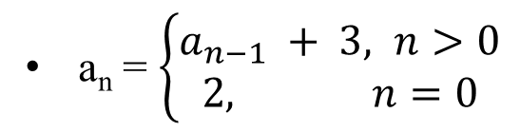
EXAMPLE
Let a sequence {a_{n}} satisfies the following recurrence relation
a_{n} = $\left\{\begin{aligned}a_{n−1} + 3, n>0 \\ &2, n=0\end{aligned}\right.$
a_{n} = a_{n-1} + 3 for n > 0
a₀ = 2
Find, a₁, a₂, a₃
a₁ = a₀ + 3
= 2 + 3
= 5
a₂ = a₁ + 3
= 5 + 3
= 8
a₃ = a₂ + 3
= 8 + 3
= 11

Slide 61
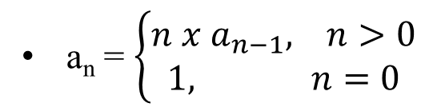
EXAMPLE
Let a sequence {a_{n}} where the n-th term denotes n!. n = 0, 1, 2, 3, …
For example the sequence is {1, 1, 2, 6, 24, 120, 720, ……..}
Find a recurrence relation that satisfies the sequence
And using the recurrence relation find a₅
a_{n} = $\left\{\begin{aligned}{n x a}_{n−1}, n>0 \\ &1, n=0\end{aligned}\right.$
a_{n} = n x a_{n-1} for n > 0
a₀ = 1
a₅ = 5 x a₄
What if, a₀ would not be given?
= 5 x 4 x a₃
It would be infinite
= 5 x 4 x 3 x a₂
a₀ would become 0 x a₋₁
= 5 x 4 x 3 x 2 x a₁
a₋₁ would become -1 x a₋₂
= 5 x 4 x 3 x 2 x 1 x a₀
= 5 x 4 x 3 x 2 x 1 x 1
= 120
a₃ = a₂ + 3
= 8 + 3
= 11

Slide 62
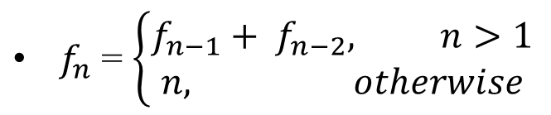
FIBONACCI SERIES
Each term in the series is the summation of the previous two term
Initial two terms are 0 and 1
The series is: 0, 1,
1,
2,
3,
5,
8,
13,
21………
Find the recurrence relation for this series
f_{n} = f_{n-1} + f_{n-2}
$f_{n}$= $\left\{\begin{aligned}{f_{n−1}+ f}_{n−2}, n>1 \\ &n, otherwise\end{aligned}\right.$
f₀ = 0
f₁ = 0
Find f₄ (4-th Fibonacci number) using the recurrence relation

Slide 63
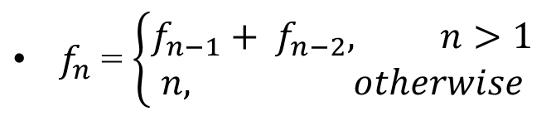
FIBONACCI SERIES
f_{n} = f_{n-1} + f_{n-2}
$f_{n}$= $\left\{\begin{aligned}{f_{n−1}+ f}_{n−2}, n>1 \\ &n, otherwise\end{aligned}\right.$
f₀ = 0
f₁ = 0
Find f₄ (4-th Fibonacci number) using the recurrence relation
f₄ = f₃ + f₂
= f₂+ f₁ +f₁ + f₀
= f₁ + f₀ + 1 + 1 + 0
= 1 + 0 + 1 + 1 + 0
= 3

Slide 64
FIBONACCI SERIES
f_{n} = f_{n-1} + f_{n-2}
$f_{n}$= $\left\{\begin{aligned}{f_{n−1}+ f}_{n−2}, n>1 \\ &n, otherwise\end{aligned}\right.$
f₀ = 0
f₁ = 0
Illustrate f₅ using the recurrence relation as a tree
f₅
5
+
3
2
f₄
f₃
+
+
2
1
1
1
f₃
f₂
f₂
f₁
+
+
+
1
1
f₂
f₁
f₁
f₀
1
f₁
f₀
0
+
1
0
1
f₁
f₀
0

Slide 65
EXAMPLE
A person deposits $10000 in a savings account
The annual rate of interest over the annual savings is 11%
Determine the amount of money in his account after 30 years
Let, P_{n} is the amount after n years
Need to determine P₃₀
P₀ is the initial amount, P₀ = 10000
P₁ = P₀ + 0.11P₀
P₁ = 1.11P₀
P₂ = P₁ + 0.11P₁
P₂ = 1.11P₁
P₂ = (1.11)² P₀
P₃ = P₂ + 0.11P₂
P₃ = 1.11P₂
P₃ = (1.11)³ P₀
P₄ = P₃ + 0.11P₃
P₄ = 1.11P₃
P₄ = (1.11)⁴ P₀
P₃₀ = (1.11)³⁰ P₀
P₃₀ = $2,28,922,97

Slide 66
SEQUENCE

Slide 67

INTRODUCTION
Consider a sequence: {a_{n}}
a₁, a₂, a₃, ….., a_{n}
The symbol of summation $\sum_{J=p}^{q}{a_{J}}$ used to determine:
The sum of the elements from p^{th} term to q^{th} term of the sequence
That implies: a_{p} + a_{p+1} + a_{p+2} + ….. + a_{q}
j is the summation-variable
It implies that j starts from p and ends at q
j = p
a_{p}
j = p+1
a_{p+1}
j = q
a_{q}
$$Σ$$
a_{p} + a_{p+1} + … + a_{q}

Slide 68
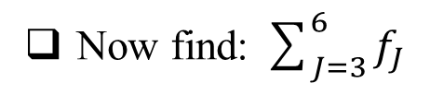
EXAMPLE
Consider a sequence: {f_{n}} that denotes a Fibonacci sequence
The sequence is indexed from 0
Now find: $\sum_{J=3}^{6}{f_{J}}$
0
1
1
2
3
5
8
13
21
34
f₀
f₁
f₂
f₃
f₄
f₅
f₆
f₇
f₈
f_{9 …….}
What are the values of j?
In first step: j = 3
Then the term is: f₃
In second step: j = 4
Then the term is: f₄
In third step: j = 5
Then the term is: f₅
In forth step: j = 6
Then the term is: f₆
The result is: f₃ + f₄+ f₅ + f₆ = 2 + 3 + 5 + 8 = 18

Slide 69
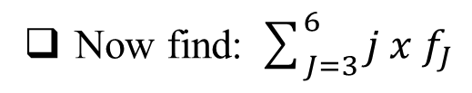
EXAMPLE
Consider a sequence: {f_{n}} that denotes a Fibonacci sequence
The sequence is indexed from 0
Now find: $\sum_{J=3}^{6}{{j x f}_{J}}$
0
1
1
2
3
5
8
13
21
34
f₀
f₁
f₂
f₃
f₄
f₅
f₆
f₇
f₈
f_{9 …….}
What are the values of j?
In first step: j = 3
Then the term is: 3 x f₃
In second step: j = 4
Then the term is: 4 x f₄
In third step: j = 5
Then the term is: 5 x f₅
In forth step: j = 6
Then the term is: 6 x f₆
The result is: 3xf₃ + 4xf₄+ 5xf₅ + 6xf₆ = 3x2 + 4x3 + 5x5 + 6x8 = 91

Slide 70
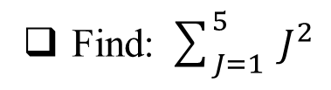
EXAMPLE
Find: $\sum_{J=1}^{5}{ J^{2}}$
What are the values of j?
In first step: j = 1
Then the term is: 1
In second step: j = 2
Then the term is: 4
In third step: j = 3
Then the term is: 9
In forth step: j = 4
Then the term is: 16
In fifth step: j = 5
Then the term is: 25
So, the result is 1 + 4 + 9 + 16 + 25 = 55

Slide 71
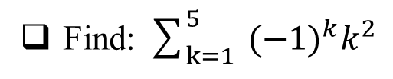
EXAMPLE
Find: $\sum_{k=1}^{5}{ {{(−1)}^{k}k}^{2}}$
What are the values of k?
In first step: k = 1
Then the term is: (-1)¹ x 1² = -1
In second step: k = 2
Then the term is: (-1)² x 2² = 4
In third step: k = 3
Then the term is: (-1)³ x 3² = -9
In forth step: k = 4
Then the term is: (-1)⁴ x 4² = 16
In fifth step: k = 5
Then the term is: (-1)⁵ x 5² = -25
So, the result is -1 + 4 - 9 + 16 - 25 = -15

Slide 72
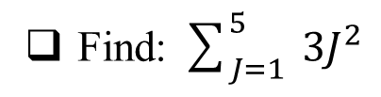
EXAMPLE
Find: $\sum_{J=1}^{5}{ {3J}^{2}}$
What are the values of j?
In first step: j = 1
Then the term is: 3
In second step: j = 2
Then the term is: 12
In third step: j = 3
Then the term is: 27
In forth step: j = 4
Then the term is: 48
In fifth step: j = 5
Then the term is: 75
So, the result is 3 + 12 + 27 + 48 + 75 = 165

Slide 73
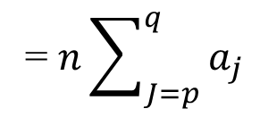
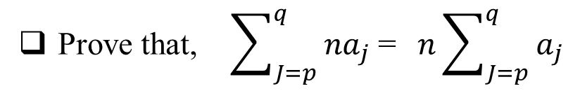
EXAMPLE
Prove that, $\sum_{J=p}^{q}{ {na}_{j}}$= $n\sum_{J=p}^{q}{ a_{j}}$
What are the values of j?
j = p
L.H.S term is na_{p}
j = p+1
L.H.S term is na_{p+1}
j = p+2
L.H.S term is na_{p+2}
j = q
L.H.S term is na_{q}
So, the result is: na_{p} + na_{p+1} + na_{p+2} + …. + na_{q}
= n(a_{p} + a_{p+1} + a_{p+2} + …. + a_{q})
= $n\sum_{J=p}^{q}{ a_{j}}$

Slide 74
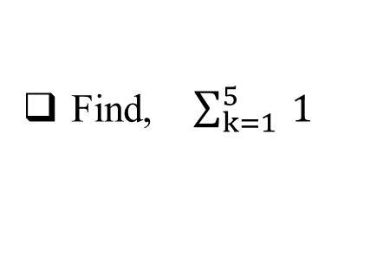
EXAMPLE
Find, $\sum_{k=1}^{5}{ 1}$
What are the values of k?
In first step: k = 1
Then the term is: 1
In second step: k = 2
Then the term is: 1
In third step: k = 3
Then the term is: 1
In forth step: k = 4
Then the term is: 1
In fifth step: k = 5
Then the term is: 1
So, the result is: 1 + 1 + 1 + 1 + 1 = 5

Slide 75
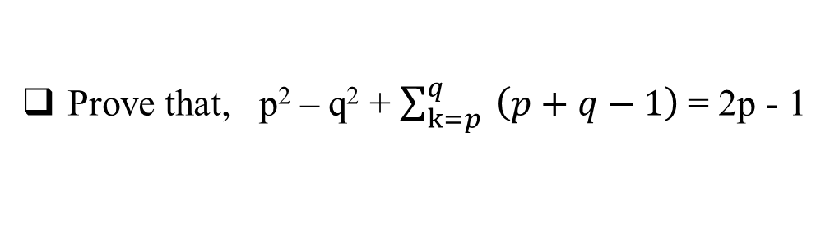
EXAMPLE
Prove that, p² – q² + $\sum_{k=p}^{q}{ \left(p+q−1\right)}$= 2p - 1
What are the values of k?
In first step: k = p
Then the term is: p + q - 1
In second step: k = p + 1
Then the term is: p + q - 1
In last step: k = q
Then the term is: p + q - 1
How many p + q - 1 will be added?
q – p + 1
Because in a range [a, b] there are total (b – a + 1) numbers
So, the result of summation is: (p + q - 1) (q – p + 1)
= (q + p - 1) (q – (p - 1))
= q² – (p – 1)²
= q² – p² + 2p - 1
Now, L.H.S = p² – q² + (q² – p² + 2p -1)
= 2p -1

Slide 76

MULTIPLE SUMMATION
Multiple summation operator with corresponding variables can be used
The inner most operator to be solved first, then the next inner and so on
$$\sum_{i=a}^{b}{\sum_{j=p}^{q}{\sum_{k=y}^{z}{expression}}}$$
The operator with variable k to be solved first, then j and then i.

Slide 77
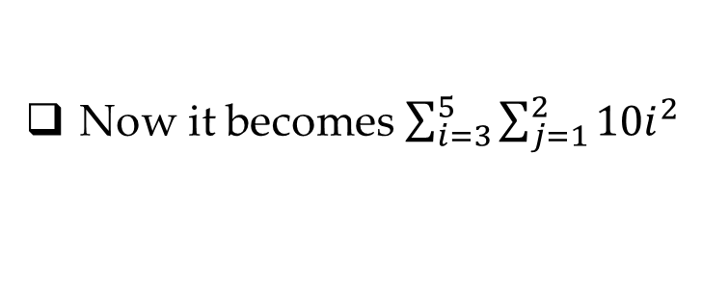
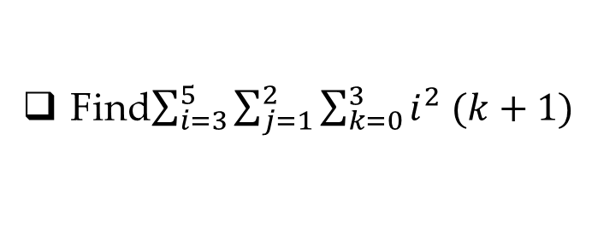
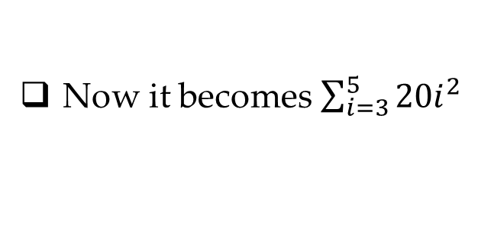
EXAMPLE
Find$\sum_{i=3}^{5}{\sum_{j=1}^{2}{\sum_{k=0}^{3}{i^{2} (k+1)}}}$
k | Expression
j | Expression
0
i²
1
10i²
1
2i²
2
10i²
2
3i²
Result
20i²
3
4i²
Now it becomes $\sum_{i=3}^{5}{{20i}^{2}}$
Result
10i²
i | Expression
Now it becomes $\sum_{i=3}^{5}{\sum_{j=1}^{2}{{10i}^{2}}}$
3
20 x 3² = 180
4
20 x 4² = 320
5
20 x 5² = 500
Result
1000
Ans: 1000

Slide 78
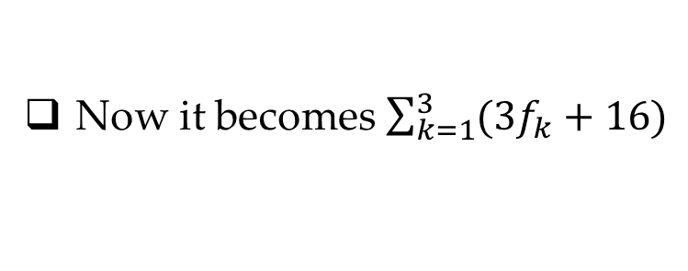
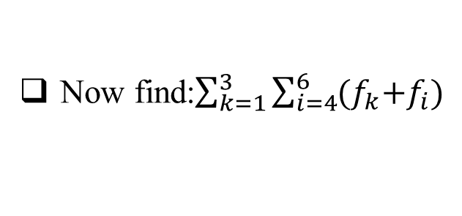
EXAMPLE
Consider a sequence: {f_{n}} that denotes a Fibonacci sequence
The sequence is indexed from 0
Now find:$\sum_{k=1}^{3}{\sum_{i=4}^{6}{{(f}_{k}{+f}_{i})}}$
i | Expression
k | Expression
4
f_{k} + f₄
= f_{k} + 3
1
3f₁ + 16
= 19
5
f_{k} + f₅
= f_{k} + 5
2
3f₂ + 16
= 19
6
f_{k} + f₆
= f_{k} + 8
3
3f₃ + 16
= 22
Result
3f_{k} + 16
Result
60
Now it becomes $\sum_{k=1}^{3}{(3f_{k}+16)}$
Ans: 60

Slide 79
THANK YOU!
ANY QUESTIONS?

